Slide 1
Basics of Switch and Router configurations
Notes:
Cisco Networking Academy program
Introduction to Network
Chapter 2: Configuring a Network Operating System

Slide 2
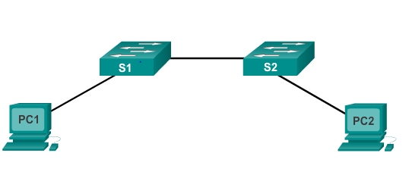
Cisco IOS Operating Systems
All networking equipment dependent on operating systems
The operating system on home routers is usually called firmware
Cisco IOS – Collection of network operating systems used on Cisco devices

Slide 3
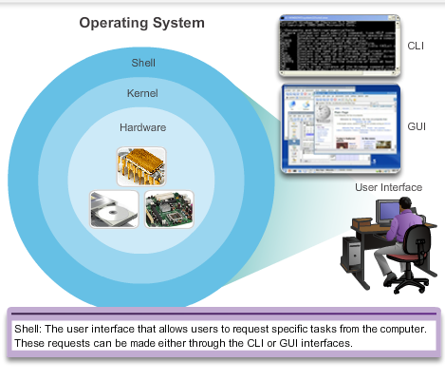
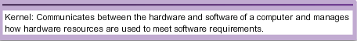
Cisco IOS Operating Systems (cont.)

Slide 4
Cisco IOS Purpose of OS
PC operating systems (Windows and OS X) perform technical functions that enable:
Use of a mouse
View output
Enter text
Switch or router IOS provides options to:
Configure interfaces
Enable routing and switching functions
All networking devices come with a default IOS
Possible to upgrade the IOS version or feature set

Slide 5
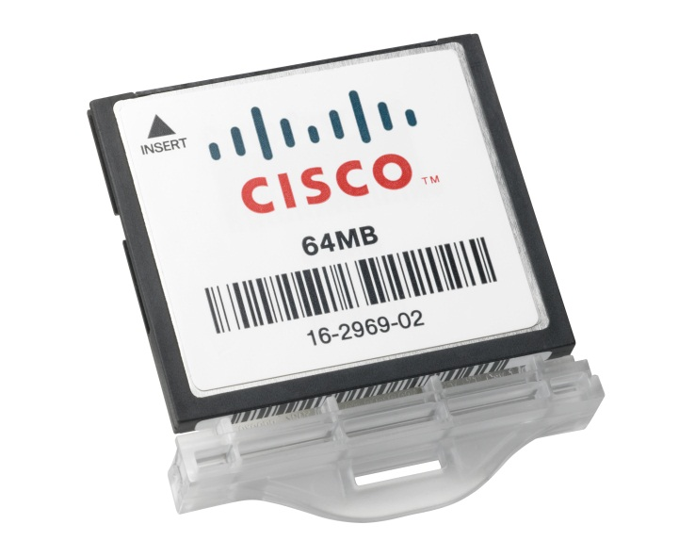
Cisco IOS Location of the Cisco IOS
Cisco IOS stored in Flash
Non-volatile storage, not lost when power is lost
Can be changed or overwritten as needed
Can be used to store multiple versions of IOS
IOS copied from flash to volatile RAM
Quantity of flash and RAM memory determines IOS that can be used

Slide 6
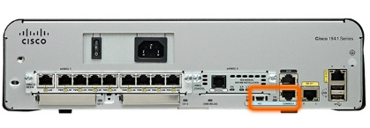
Accessing a Cisco IOS Device Console Access Method
Most common methods to access the CLI:
Console
Telnet or SSH
AUX port

Slide 7
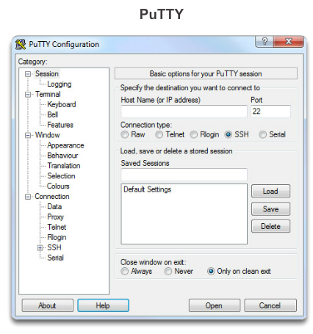
Accessing a Cisco IOS Device Terminal Emulation Programs
Software available for connecting to a networking device:
PuTTY
Tera Term
SecureCRT
HyperTerminal
OS X Terminal

Slide 8
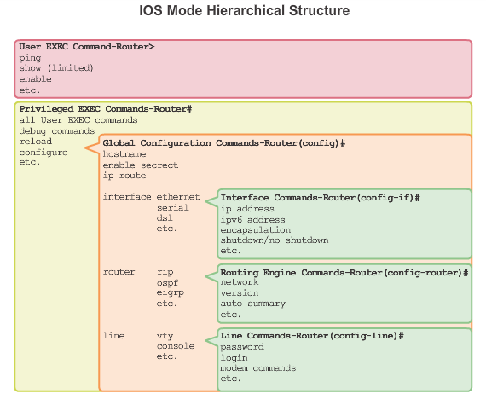
Navigating the IOS Cisco IOS Modes of Operation
Notes:
2.1.3.1 Cisco IOS Modes of Operations
In hierarchical order from most basic to most specialized, the major modes are:
User executive (User EXEC) mode
Privileged executive (Privileged EXEC) mode
Global configuration mode
Other specific configuration modes, such as Interface configuration mode.
Each mode has a distinctive prompt

Slide 9
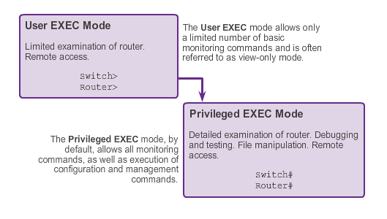
Navigating the IOS Primary Modes
Notes:
2.1.3.2 Primary Modes
The two primary modes of operation are user EXEC mode and privileged EXEC mode. Tthe privileged EXEC mode has a higher level of authority in what it allows the user to do with the device.
User EXEC Mode
The user EXEC mode has limited capabilities but is useful for some basic operations. This mode is the first mode encountered upon entrance into the CLI of an IOS device.
This is often referred to as view-only mode. The user EXEC level does not allow the execution of any commands that might change the configuration of the device.
By default, there is no authentication required to access the user EXEC mode from the console. However, it is a good practice to ensure that authentication is configured during the initial configuration.
The user EXEC mode is identified by the CLI prompt that ends with the > symbol. This is an example that shows the > symbol in the prompt: Switch>
Privileged EXEC Mode
The execution of configuration and management commands requires that the network administrator use the privileged EXEC mode, or a more specific mode in the hierarchy.
The privileged EXEC mode can be identified by the prompt ending with the #symbol. Switch#
By default, privileged EXEC mode does not require authentication.
Global configuration mode and all other more specific configuration modes can only be reached from the privileged EXEC mode.

Slide 10
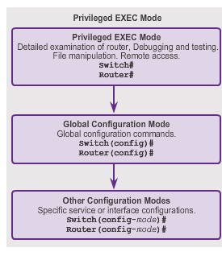
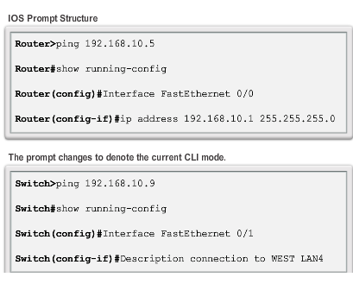
Navigating the IOS Global Configuration Mode and Submodes
Notes:
2.1.3.3 Global Configuration Mode and Submodes
Global configuration mode and interface configuration modes can only be reached from the privileged EXEC mode.
From global config, CLI configuration changes are made that affect the operation of the device as a whole.
Switch# configure terminal
Switch(config)#
From the global config mode, the user can enter different subconfiguration modes. Each of these modes allows the configuration of a particular part or function of the IOS device.
Interface mode - to configure one of the network interfaces (Fa0/0, S0/0/0)
Line mode - to configure one of the physical or virtual lines (console, AUX, VTY)
To exit a specific configuration mode and return to global configuration mode, enter exit at a prompt. To leave configuration mode completely and return to privileged EXEC mode, enter end or use the key sequence Ctrl-Z.
As commands are used and modes are changed, the prompt changes to reflect the current context.

Slide 11
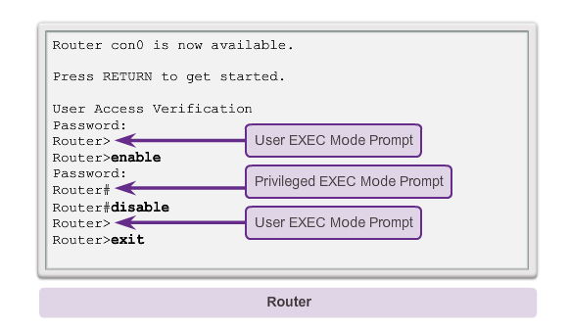
Navigating the IOS Navigating Between IOS Modes
Notes:
2.1.3.4 Navigating between IOS Modes
The enable and disable commands are used to change the CLI between the user EXEC mode and the privileged EXEC mode, respectively.

Slide 12
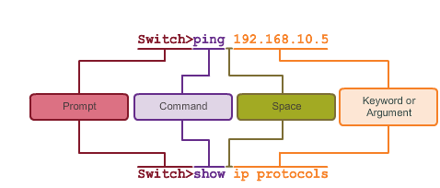
The Command Structure IOS Command Structure
Notes:
2.1.4.1 IOS Command Structure
Each IOS command has a specific format or syntax and can only be executed at the appropriate mode.
The commands are not case-sensitive. Following the command are one or more keywords and arguments.
Unlike a keyword, an argument is generally not a predefined word. An argument is a value or variable defined by the user
Switch> ping IP address
Switch> ping 10.10.10.5
The command is ping and the user defined argument is the 10.10.10.5.
Similarly, the syntax for entering thetraceroute command is:
Switch> traceroute IP address
Switch> traceroute 192.168.254.254
The command is traceroute and the user defined argument is the 192.168.254.254.

Slide 13
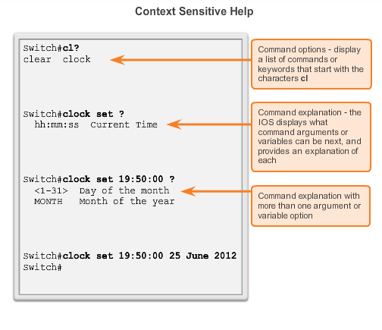
The Command Structure Context-Sensitive Help
Notes:
2.1.4.3 Context Sensitive Help
The IOS has several forms of help available:
Context-sensitive help
Command Syntax Check
Hot Keys and Shortcuts

Slide 14
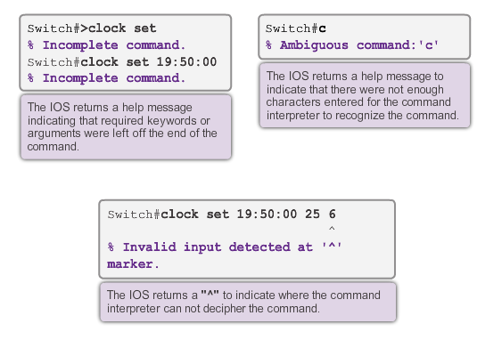
The Command Structure Command Syntax Check
Notes:
2.1.4.4 Command Syntax Check
There are three different types of error messages:
Ambiguous command
Incomplete command
Incorrect command

Slide 15
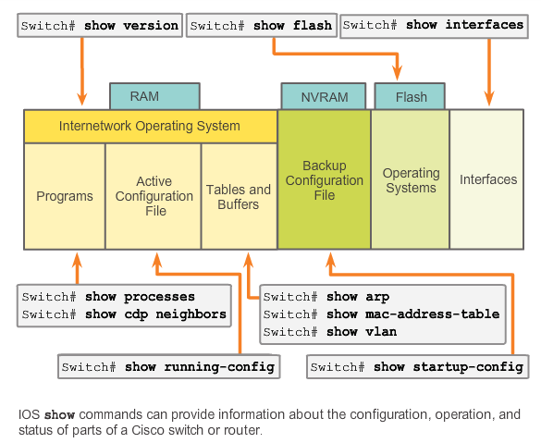
The Command Structure IOS Examination Commands
Notes:
2.1.4.6 IOS Examination Commands
Use the show ? command to get a list of available commands in a given context, or mode.
A typical show command can provide information about the configuration, operation, and status of parts of a Cisco device.
A very commonly used show command is show interfaces. This command displays statistics for all interfaces on the device. To view the statistics for a specific interface, enter the show interfaces command followed by the specific interface type and slot/port number.
Some other show commands frequently used by network technicians include:
show startup-config - Displays the saved configuration located in NVRAM.
show running-config - Displays the contents of the currently running configuration file.

Slide 16
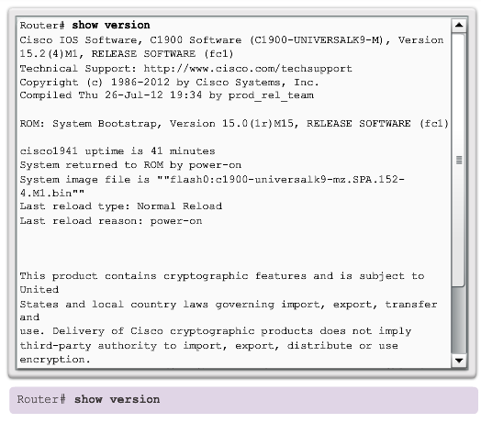
The Command Structure The show version Command
Notes:
2.1.4.7 The show version Command
This command displays information about the currently loaded IOS version, along with hardware and device information.
Software Version - IOS software version (stored in flash)
Bootstrap Version - Bootstrap version (stored in Boot ROM)
System up-time - Time since last reboot
System restart info - Method of restart (e.g., power cycle, crash)
Software image name - IOS filename stored in flash
Router Type and Processor type - Model number and processor type
Memory type and allocation (Shared/Main) - Main Processor RAM and Shared Packet I/O buffering
Software Features - Supported protocols / feature sets
Hardware Interfaces - Interfaces available on the device
Configuration Register - Sets bootup specifications, console speed setting, and related parameters

Slide 17
Getting Basic
Notes:
2.2 Getting Basic

Slide 18
Hostnames Why the Switch
Creating a two PC network connected via a switch
Setting a name for the switch (hostname S1)
Configuring banner messages
Saving the configuration
Notes:
2.2.1.1 Why the Switch

Slide 19
Securing Device Access
These are device access passwords:
enable password – Limits access to the privileged EXEC mode
enable secret – Encrypted, limits access to the privileged EXEC mode
console password – Limits device access using the console connection
VTY password – Limits device access over Telnet
Note: In most of the labs in this course, we will be using simple passwords such as cisco or class.

Slide 20
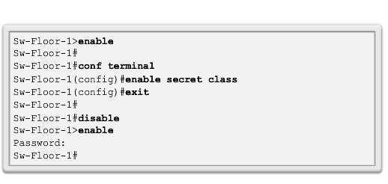
Securing Privileged EXEC Access Mode
Use the enable secret command, not the older enable password command.
The enable secret command provides greater security because the password is encrypted.
Notes:
2.2.2.2 Securing Privileged EXEC Access

Slide 21
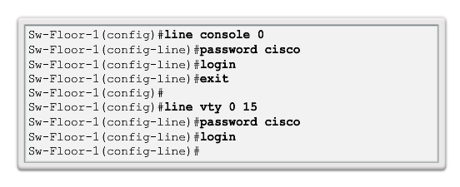
Securing User EXEC Access
Console port must be secured; it reduces the chance of unauthorized personnel physically plugging a cable into the device and gaining device access.
VTY lines allow access to a Cisco device via Telnet. The number of VTY lines supported varies with the type of device and the IOS version.
Notes:
2.2.2.3 Securing User EXEC Access

Slide 22
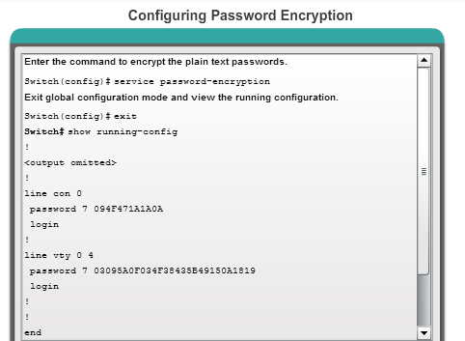
Encrypting Password Display
service password-encryption
Prevents passwords from showing up as plain text when viewing the configuration
Notes:
2.2.2.4 Encrypting Password Display

Slide 23
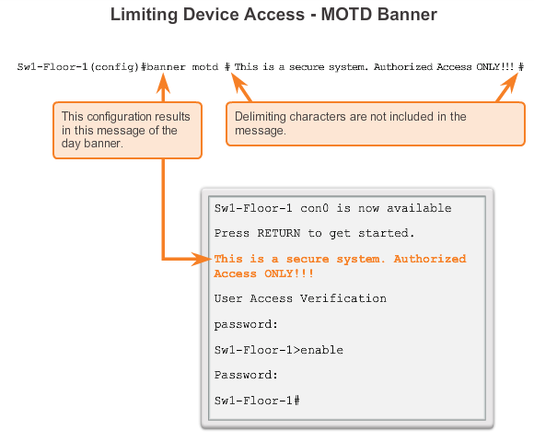
Limiting Access to Device Configurations Banner Messages
Important part of the legal process in the event that someone is prosecuted for breaking into a device
Wording that implies that a login is "welcome" or "invited" is not appropriate
Often used for legal notification because it is displayed to all connected terminals
Notes:
2.2.2.5 Banner Messages

Slide 24
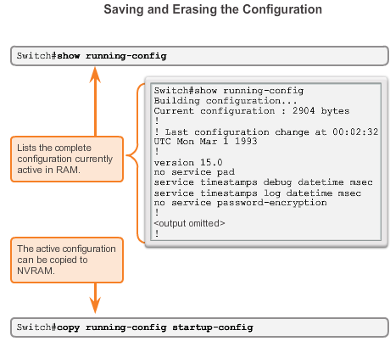
Saving Configurations Configuration Files
Switch# reload
System configuration has been modified. Save? [yes/no]: n
Proceed with reload? [confirm]
Startup configuration is removed by
Switch# erase startup-config
Notes:
2.2.3.1 Configuration Files
Switch# erase startup-config
After the command is issued, the switch will prompt you for confirmation:
Erasing the nvram filesystem will remove all configuration files! Continue? [confirm]
Confirm is the default response. To confirm and erase the startup configuration file, press . Pressing any other key will abort the process.

Slide 25
Addressing Schemes

Slide 26
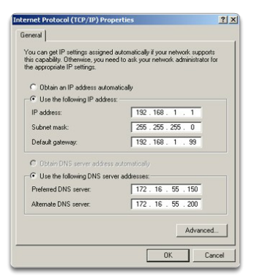
Ports and Addresses IP Addressing of Devices
Each end device on a network must be configured with an IP address.
Structure of an IPv4 address is called dotted decimal.
IP address displayed in decimal notation, with four decimal numbers between 0 and 255.
With the IP address, a subnet mask is also necessary.
Notes:
2.3.1.1 IP Addressing of Devices

Slide 27
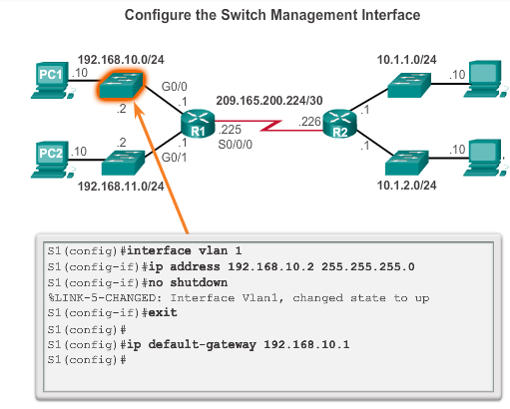
Enable IP on a Switch
Network infrastructure devices require IP addresses to enable remote management.
On a switch, the management IP address is assigned on a virtual interface.
Notes:
4.1.2.7 Enable IP on a Switch
4.1.2.8 Activity – Document an Addressing Scheme
4.1.2.9 Packet Tracer – Documenting the Network

Slide 28
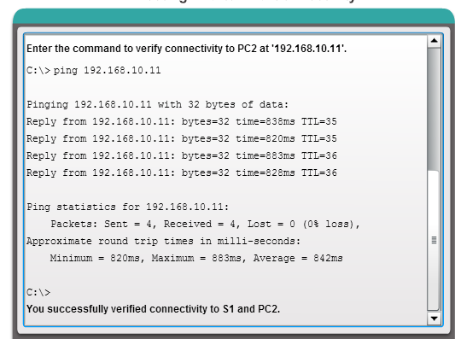
Verifying Connectivity Testing End-to-End Connectivity

Slide 29
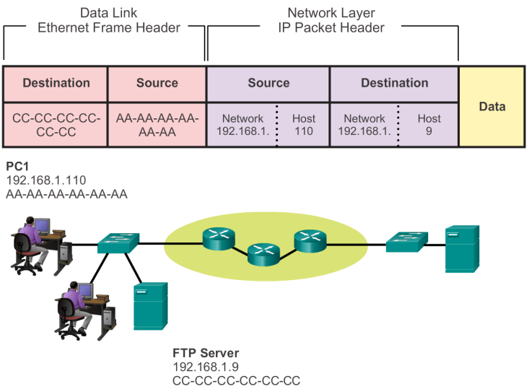

Communicating in Same Network
Notes:
3.3.2.2 Communicating with a Device on the Same Network

Slide 30


MAC and IP Addresses
R1
192.168.1.1
11-11-11-11-11-11
ARP
Request
PC1
192.168.1.110
AA-AA-AA-AA-AA-AA
S1
R1
PC2
192.168.1.111
BB-BB-BB-BB-BB-BB
FTP Server
192.168.1.9
CC-CC-CC-CC-CC-CC
Notes:
3.3.2.3 MAC and IP Addresses

Slide 31
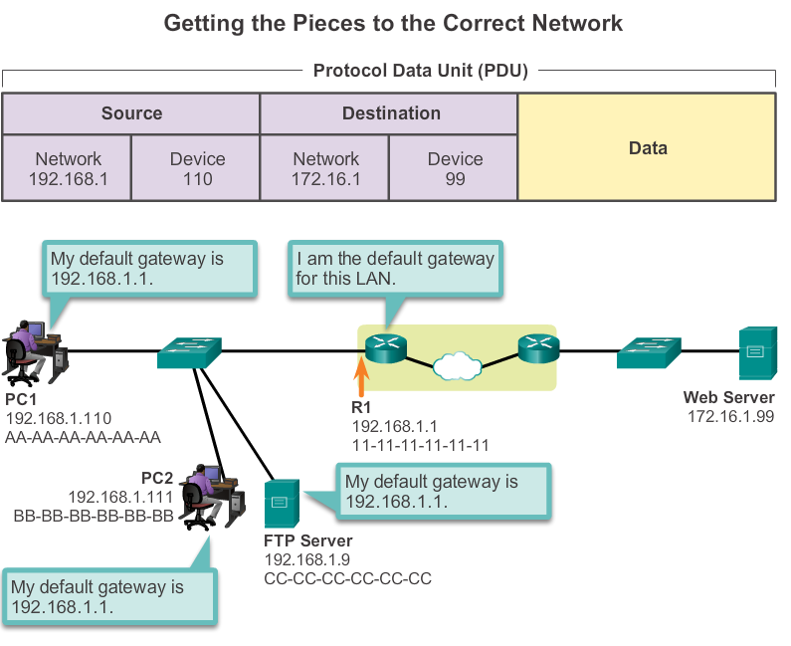
Default Gateway
Notes:
3.3.3.1 Default Gateway

Slide 32
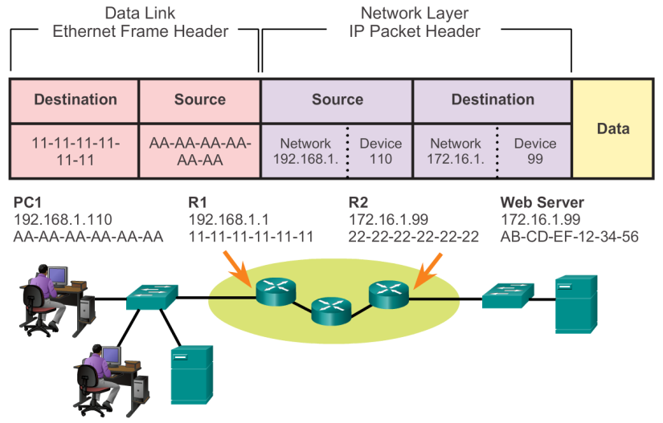
Communicating with Remote Network

Slide 33
Switch Configuration

Slide 34
Preparing for Basic Switch Management
To remotely manage a Cisco switch, it must be configured to access the network.
An IP address and a subnet mask must be configured.
If managing the switch from a remote network, a default gateway must also be configured.
The IP information (address, subnet mask, gateway) is to be assigned to a switch switch virtual interface (SVI).
Notes:
2.1.1.4 Preparing for Basic Switch Management

Slide 35
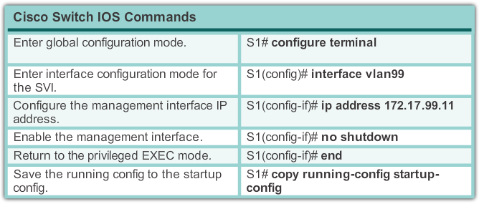
Basic Switch Configuration Preparing for Basic Switch Management (cont.)
Notes:
2.1.1.4 Preparing for Basic Switch Management

Slide 36
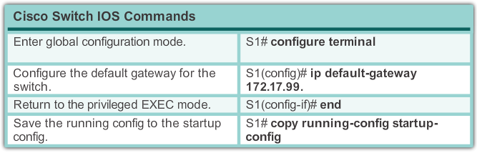
Basic Switch Configuration Preparing for Basic Switch Management (cont.)
Notes:
2.1.1.4 Preparing for Basic Switch Management

Slide 37
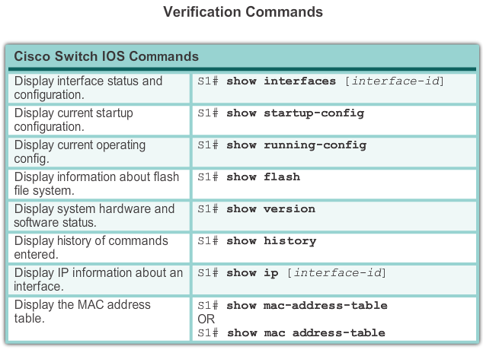
Configuring Switch Ports Verifying Switch Port Configuration
Notes:
2.1.2.4 Verifying Switch Port Configuration

Slide 38
Switch Port Security: Operation
Port security limits the number of valid MAC addresses allowed on a port.
The MAC addresses of legitimate devices are allowed access, while other MAC addresses are denied.
Any additional attempts to connect by unknown MAC addresses generate a security violation.
Secure MAC addresses can be configured in a number of ways:
Static secure MAC addresses
Dynamic secure MAC addresses
Sticky secure MAC addresses

Slide 39
Switch Port Security Port Security: Violation Modes
IOS considers a security violation when either of these situations occurs:
The maximum number of secure MAC addresses for that interface have been added to the CAM, and a station whose MAC address is not in the address table attempts to access the interface.
An address learned or configured on one secure interface is seen on another secure interface in the same VLAN.
There are three possible actions to take when a violation is detected:
Protect
Restrict
Shutdown
Notes:
2.2.4.4 Port Security: Violation Modes

Slide 40
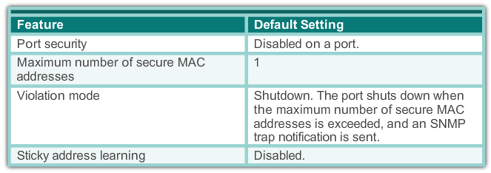
Switch Port Security Dynamic Port Security Defaults
Notes:
2.2.4.5 Dynamic Port Security Defaults

Slide 41
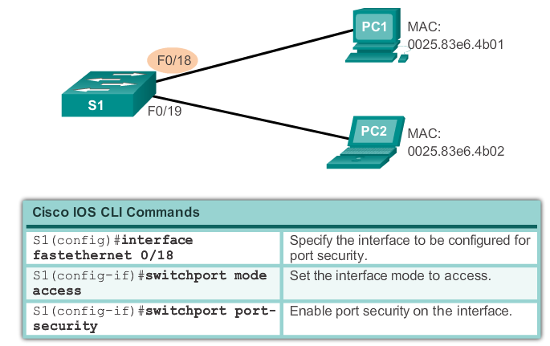
Switch Port Security Configuring Dynamic Port Security
Notes:
2.2.4.5 Configuring Dynamic Port Security

Slide 42
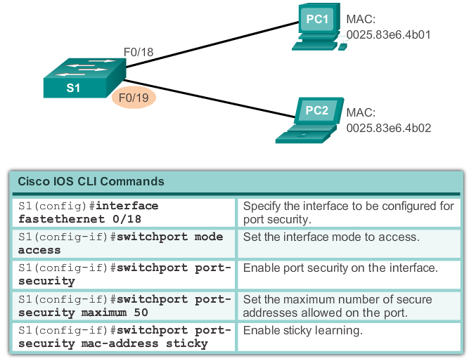
Switch Port Security Configuring Port Security Sticky
Notes:
2.2.4.5 Configuring Port Security Sticky

Slide 43
Routing Concepts

Slide 44
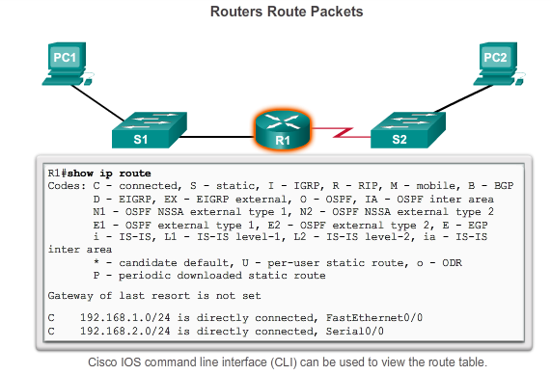
Functions of a Router Why Routing?
The router is responsible for the routing of traffic between networks.

Slide 45
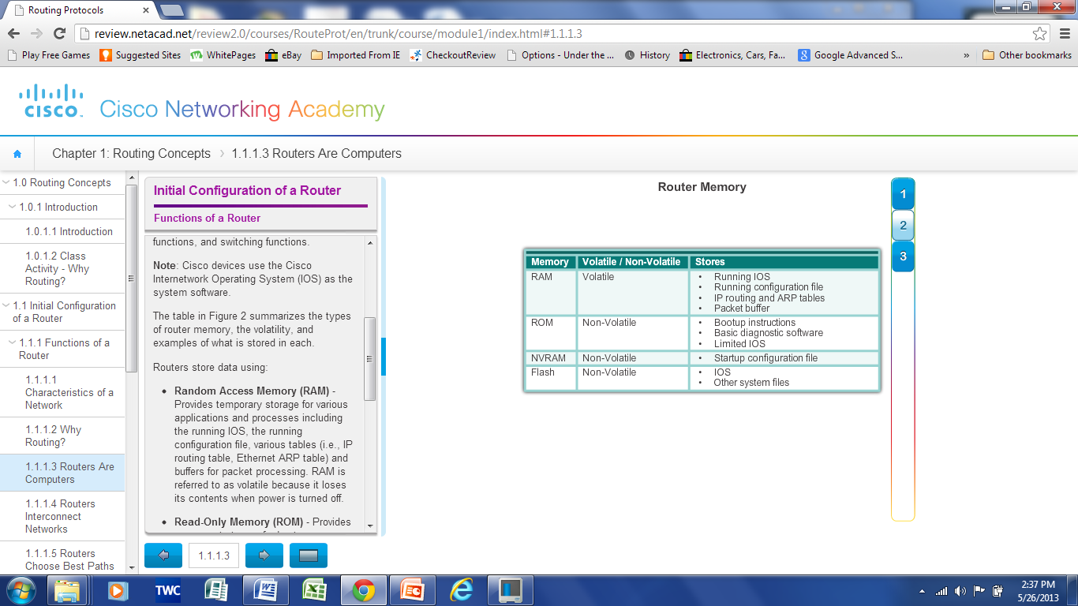
Functions of a Router Routers are Computers
Routers are specialized computers containing the following required components to operate:
Central processing unit (CPU)
Operating system (OS) - Routers use Cisco IOS
Memory and storage (RAM, ROM, NVRAM, Flash, hard drive)
Notes:
4.1.1.3 Routers are Computers

Slide 46
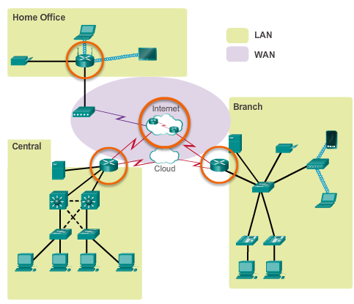
Functions of a Router Routers Interconnect Networks
Routers can connect multiple networks.
Routers have multiple interfaces, each on a different IP network.
Notes:
4.1.1.4 Routers Interconnect Networks

Slide 47
Functions of a Router Routers Choose Best Paths
Routers use static routes and dynamic routing protocols to learn about remote networks and build their routing tables.
Routers use routing tables to determine the best path to send packets.
Routers encapsulate the packet and forward it to the interface indicated in routing table.
Notes:
4.1.1.5 Routers Choose Best Paths

Slide 48
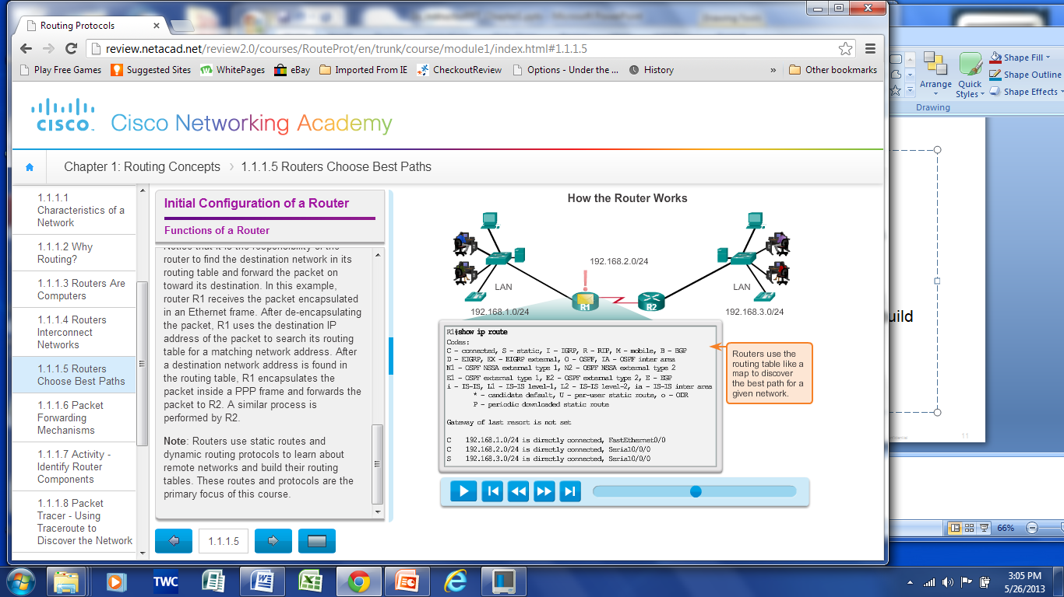
Functions of a Router Routers Choose Best Paths
Notes:
4.1.1.5 Routers Choose Best Paths

Slide 49
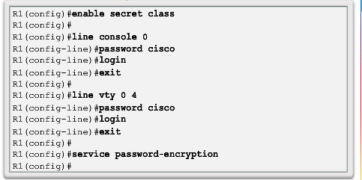
Basic Settings on a Router Configure Basic Router Settings
Basics tasks that should be first configured on a Cisco Router and Cisco Switch:
Name the device – Distinguishes it from other routers
Secure management access – Secures privileged EXEC, user EXEC, and Telnet access, and encrypts passwords to their highest level
Configure a banner – Provides legal notification of unauthorized access.
Save the Configuration
Notes:
4.1.3.1 Configure Basic Router Settings

Slide 50
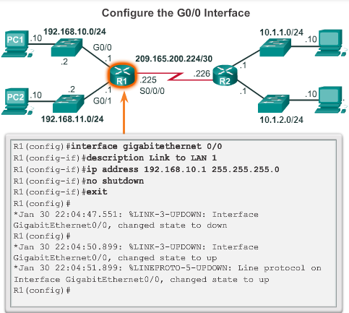
Basic Settings on a Router Configure an IPv4 Router Interface
To be available, a router interface must be:
Configured with an address and subnet mask .
Must be activated using no shutdown command. By default LAN and WAN interfaces are not activated.
Serial cable end labeled DCE must be configured with the clock rate command.
Optional description can be included.
Notes:
4.1.3.2 Configure an IPv4 Router Interface

Slide 51
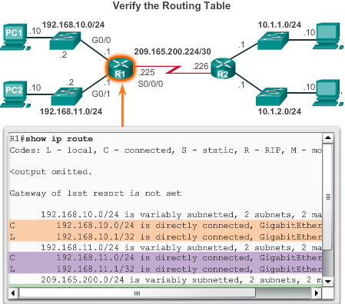
Verify Connectivity of Directly Connected Networks Verify Interface Settings
Show commands are used to verify operation and configuration of interface:
show ip interfaces brief
show ip route
show running-config
Show commands are used to gather more detailed interface information:
show interfaces
show ip interfaces
Notes:
4.1.4.1 Verify Interface Settings

Slide 52
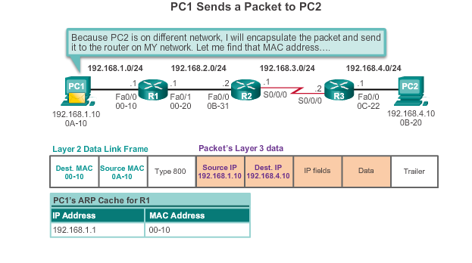
Switching Packets between Networks Send a Packet
Notes:
4.2.1.2 Send a Packet

Slide 53
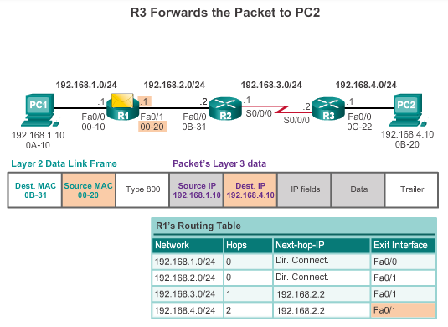
Switching Packets between Networks Forward to the Next Hop
Notes:
4.2.1.3 Forward to the Next Hop

Slide 54
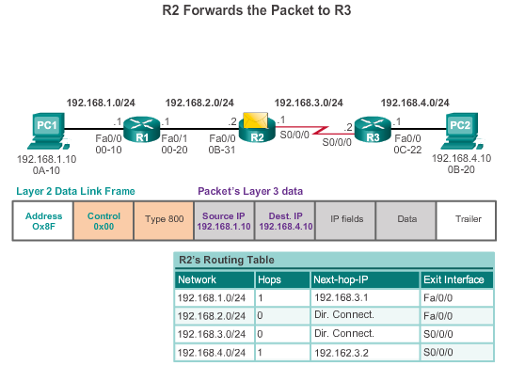
Switching Packets between Networks Packet Routing
Notes:
4.2.1.4 Packet Routing

Slide 55
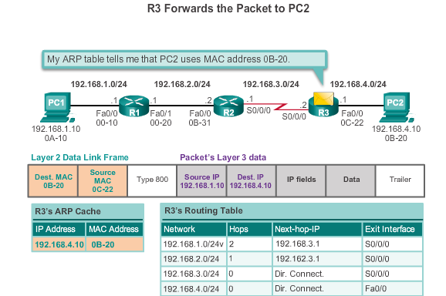
Switching Packets between Networks Reach the Destination
Notes:
4.2.1.5 Reach the Destination
4.2.1.6 Activity – Match Layer 2 and Layer 3 Addressing

Slide 56
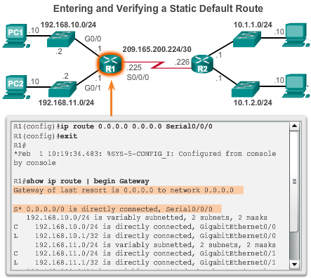
Statically Learned Routes Default Static Routes Example
Notes:
4.3.3.2 Default Static Routes Example

Slide 57
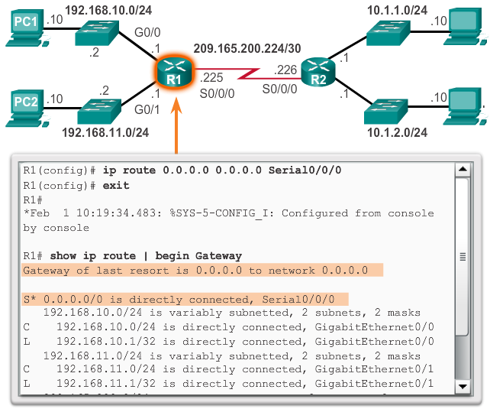
Statically Learned Routes Static Routes Example
Notes:
4.3.3.2 Static Routes Example (cont.)

Slide 58
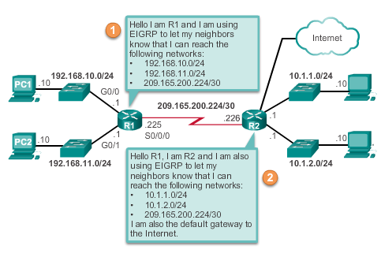
Dynamic Routing Protocols Dynamic Routing
Dynamic routing is used by routers to share information about the reachability and status of remote networks. It performs network discovery and maintains routing tables.
Notes:
4.3.4.1 Dynamic Routing

Slide 59
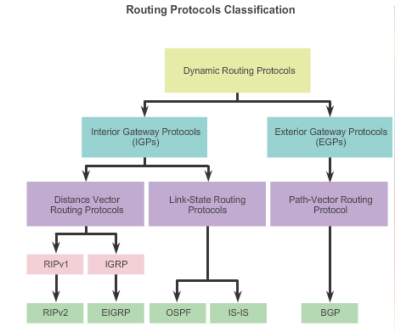
Types of Routing Protocols Classifying Routing Protocols
Notes:
7.1.4.1 Classifying Routing Protocols

Slide 60
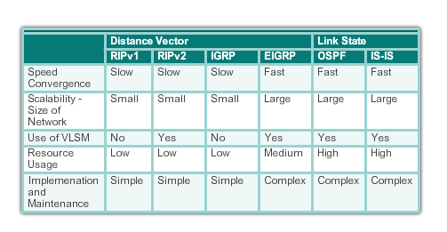
Types of Routing Protocols Routing Protocol Characteristics
Notes:
7.1.4.7 Routing Protocol Characteristics

Slide 61
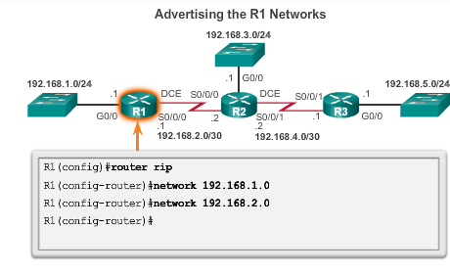
RIP Configuration
Notes:
7.3.1.1 Router RIP Configuration Mode
7.3.1.2 Advertising Networks

Slide 62


Configuring the RIP Protocol Configuring Passive Interfaces
Sending out unneeded updates on a LAN impacts the network in three ways:
Wasted Bandwidth
Wasted Resources
Security Risk
Notes:
7.3.1.6 Configuring Passive Interfaces

Slide 63


Configuring the RIP Protocol Propagating a Default Route
Notes:
7.3.1.7 Propagating a Default Route

